Slide 1
Project MIS
6900
Sprint - I

Slide 2
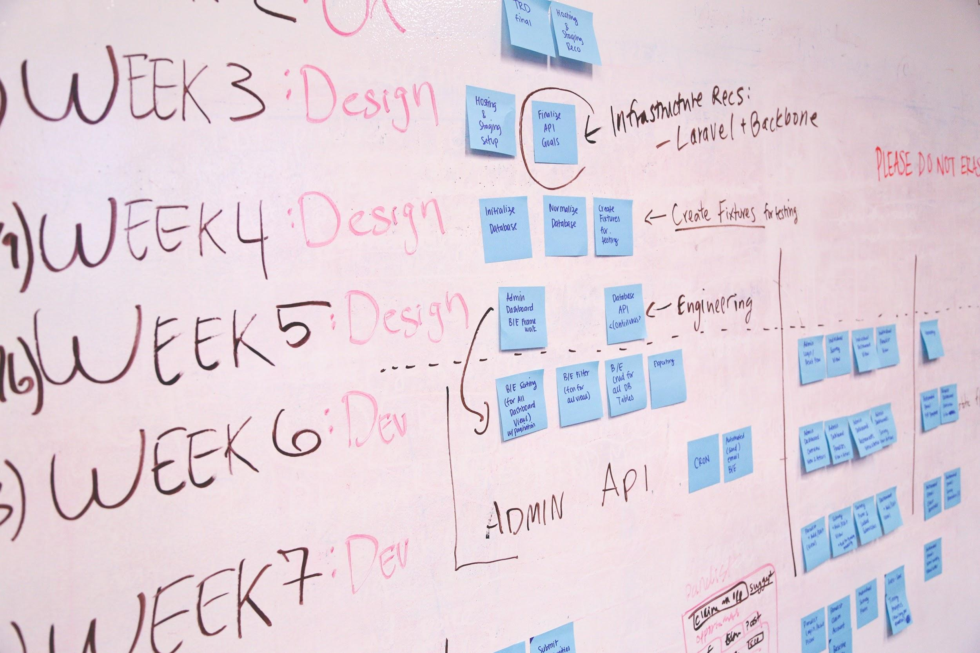
Team
Team members:
Chetan Birthare
Yixin Zhao
Kumar Akshat

Slide 3
Members Responsibility:
Kumar Akshat
Backend
Chetan Birthare
Backend
Yixin Zhao
Frontend

Slide 4
Spring goal
Finish the Landing page, registration and login page
2. Finish the login and registration part in back-end
3. Cleaning the stock data in backend and get it ready to use for front-end.

Slide 5
Back-end data API
Alpha-vantage
Data Extracted as Dictionary
Data Cleaning
Specific Data selected, rest are removed. Result is stored as .csv file
Fast Update
Re-run of program for any ticker will just get the data not already available, saving time. Fast, efficient and quick results.

Slide 6
Front end
Landing page and forms
Clean UI Which only Login, registration button on the top of the landing page.
Finish log in/out logic.
Sidebar
Sidebar should have four button with on market status which is integrated with external api.
Top bar and Search
Top bar should show user account balance and search bar with the autocomplete functionality.

Slide 7
Product Backlog:
Setup the landing page- high, Size - 2
Setup the login & register page -high, Size - 4
Cleaning the data for backend -high, Size - 4
Scriping the stock data from 1999 to now including all company in US - High, Size -4
Make back-end can auto update every 24h -medium, Size - 3
Setup the logic for user login and logout - Medium, Size - 3
Setup the sidebar for multiple page: Priority - Medium, Size - 3
Setup the top bar for multiple page: Priority - Medium, Size - 3
Setup the logic for search bar autocomplete- Low, Size - 4
Log out the data into a json file - Low, Size -3

Slide 8
Accepted Criteria:
Clean layout in landing page
Given a user when user fill out the login or register form, then user information should be handled by backend and stored in database.
Make all the stock data should sorted by time and company name
When user is typing in search bar the autocompletion algo should run
Proper Data json output
Accurate data storage
Back-end auto update

Slide 9

Project progress - Landing

Slide 10


Login & register

Slide 11
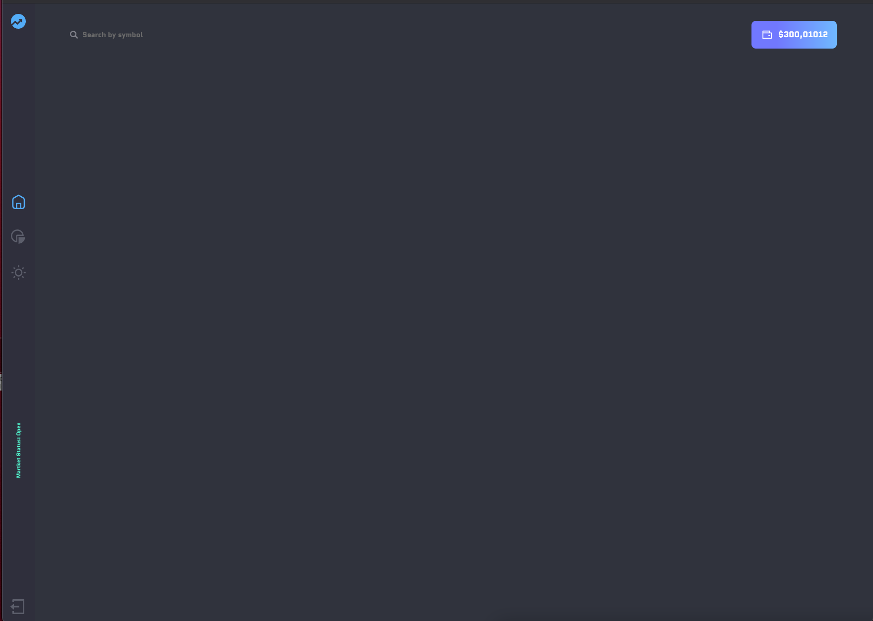
Topbar & side bar

Slide 12
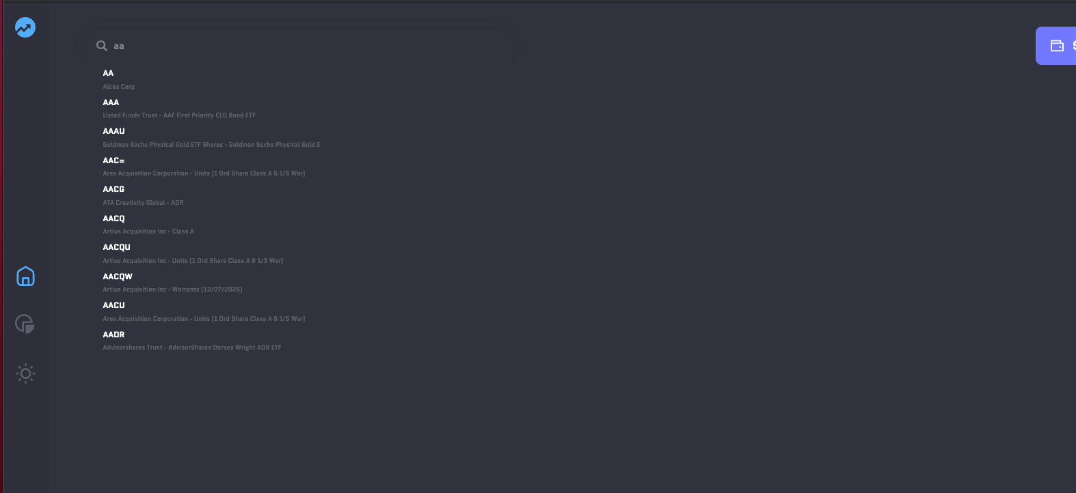
Autocompletion Logic

Slide 13
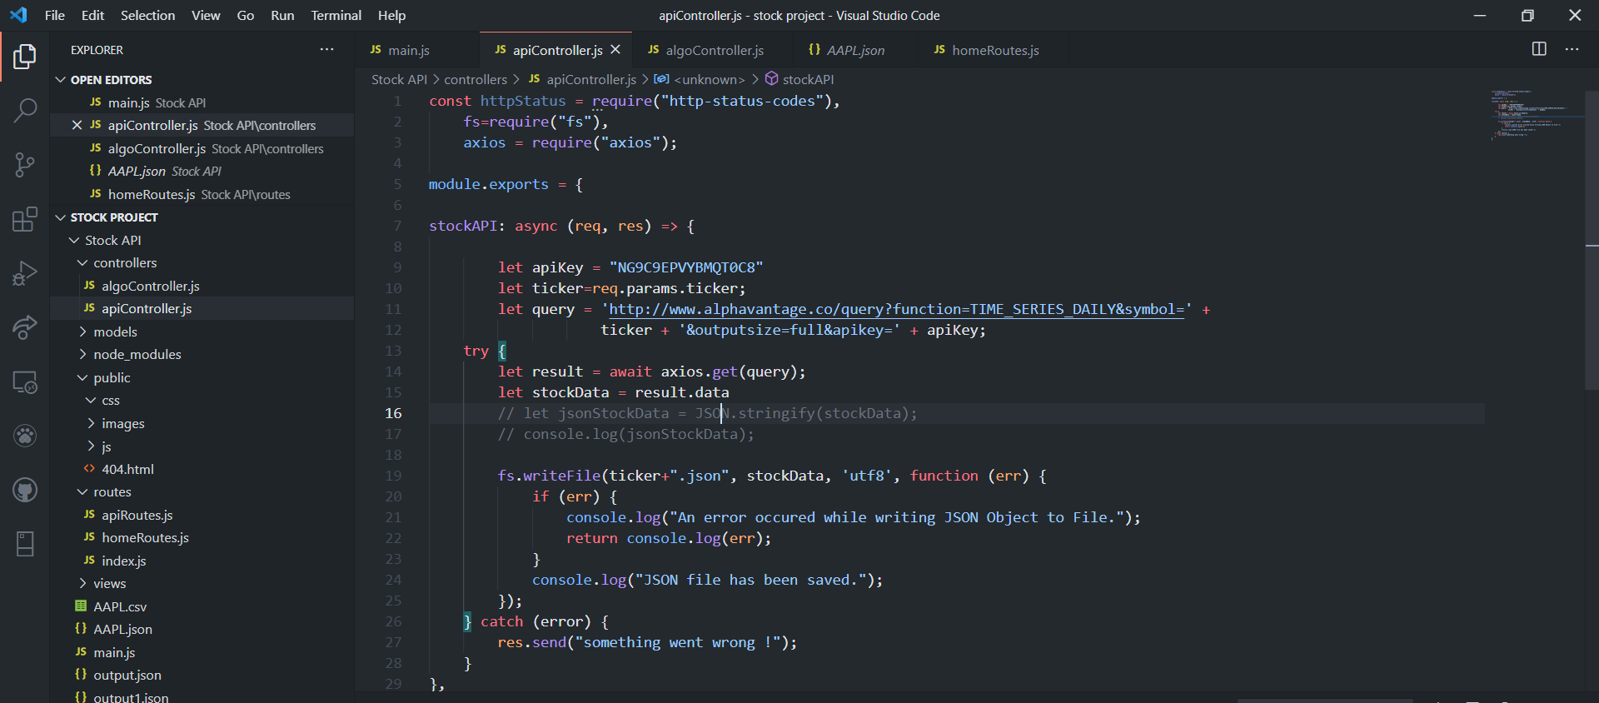
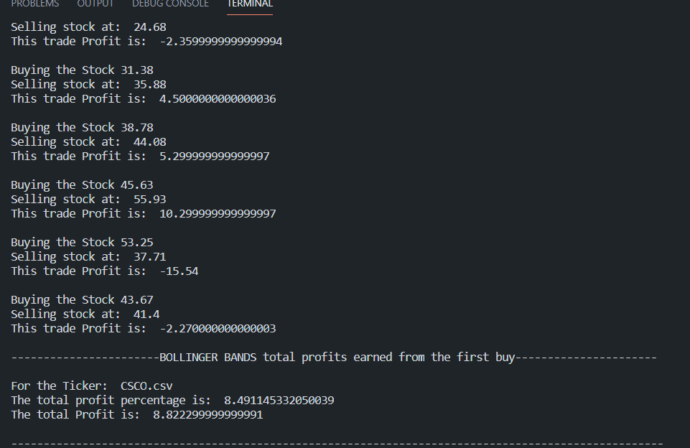
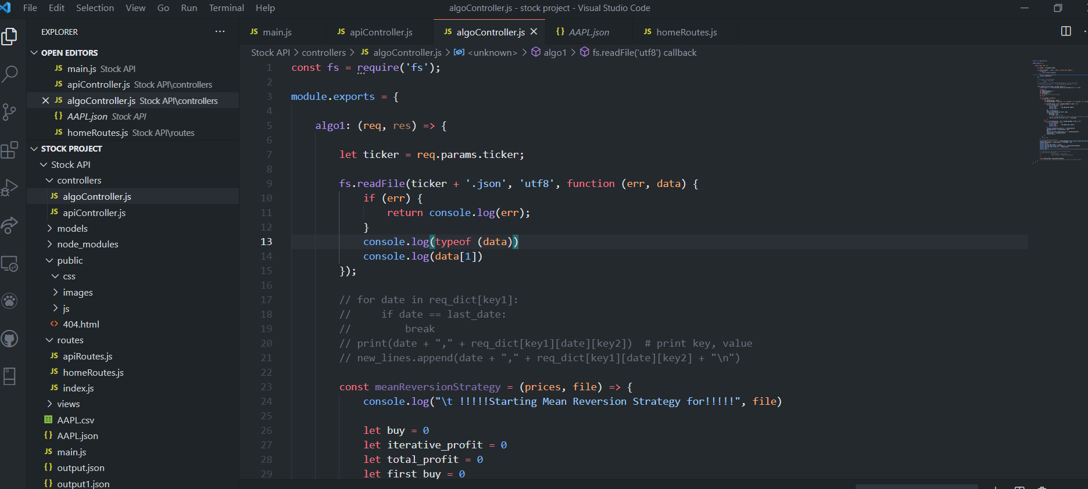
Data collection/ cleaning/ file output/ one algo

Slide 15


Good luck!
To all of us!
MIS 6900

